Slide 1

MAHATMA GANDHI INSTITUTE OF TECHNOLOGY(A)
DEPARTMENT OF INFORMATION TECHNOLOGY
AN INSDUSTRY ORIENTED MINI PROJECT(IT653PC)
ON
BRAIN TUMOR CLASSIFICATION USING DEEP LEARNING
BY
D.NAGA VAISHNAVI - 23265A1203
E.ARAVIND - 23265A1204
BATCH ID:IT-25-24
IOMP Supervisor
Dr. U. Chaitanya
Assistant Professor
Internal Supervisor
Dr. CH. PREM KUMAR
Assistant Professor

Slide 2
CONTENTS
ABSTRACT
INTRODUCTION
EXISTING SYSTEM
LITERATURE SURVERY
PROBLEM STATEMENT
REQUIREMENTS
PROPOSED SYSTEM
OBJECTIVES
MODULES DESCRIPTION
METHODOLOGIES
DESIGN ARCHITECTURE&UML DIAGRAMS
APPLICATIONS
RESULTS
CONCLUSION
FUTURE ENHANCEMENT
REFERENCES

Slide 3
ABSTRACT
The project uses deep learning, specifically ResNet-50, to automatically detect and classify brain tumors from MRI images.
It accurately categorizes MRI scans into four classes: Glioma, Meningioma, Pituitary tumors and Normal.
Transfer learning is applied to enhance the model's performance using a labeled MRI dataset.
A Flask-based web application allows users to upload scans and receive real-time predictions.
The system aims to support early diagnosis and treatment by providing a reliable, accessible diagnostic tool for medical practitioners.

Slide 4
INTRODUCTION
The brain is the central organ of the human body, responsible for controlling and managing all other organs.
Brain tumors are abnormal and uncontrolled tissue growths in the brain that can interfere with normal brain function.
Tumors are categorized into malignant (e.g., gliomas) and benign (e.g., meningiomas, pituitary tumors), both of which can be harmful if not treated properly.
Early and accurate classification of brain tumors is crucial to ensure timely treatment and improve patient outcomes.
Deep learning, particularly CNNs like ResNet50, offers powerful tools for automating the classification of medical images.
ResNet50 helps overcome issues like vanishing gradients and excels at extracting features from complex MRI images.
This project uses ResNet50 to classify brain MRI images into four types: Glioma, Meningioma, Pituitary tumors, and Normal.

Slide 5
EXISTING SYSTEM
Many systems use special computer programs called CNNs to find and classify brain tumors.
Some use pre-trained models which learn faster and work better with fewer images.
Some systems first find the tumor area in the MRI and then decide what type it is.
Others use a mix of deep learning and other machine learning methods to improve accuracy.
A few systems have a web app where doctors can upload MRI scans and get quick results.

Slide 6
LITERATURE SURVEY
S.NO | AUTHOR NAMES,YEAR OF PUBLICATION | JOURNAL OR CONFERENCE NAME AND PUBLISHER NAME | METHODOLOGY/ ALGORITHM / TECHNIQUES USED | MERITS | DEMERITS | RESEARCH GAPS
1 | G.Hemanth, M. Janardhan, Suji Helen (2019) | IEEE 3rd International Conference on Trends in Electronics and Informatics(ICOEI) | Convolutional Neural Networks(CNN), Conditional Random Field(CRF),AdaBoost, SVM | High accuracy(91%), Comprehensive, Evaluation metrics | Overfitting risk due to small kernels,requires large datasets and computational resources | Limited dataset size and diversity,potential overfitting
2 | Vaishnavi R.Dhotargavi, Sneha Grampurohit, Venkamma Shalavadi, Megha Kudari,Soumya Jolad(2020) | 2020 IEEE India Council International Subsections Conference(INDISCON), IEEE | CNN and VGG-16 models used for detecting brain tumors from MRI images | Effective binary classification of tumor presence, Comparative Analysis of CNN and VGG-16 | VGG-16 showed overfitting, no Multi-class tumor classification | Only tumor presence/absence detection, Lacks tumor type/stage identification
3 | Chirag Malik, Saad Rehman, Sunil Kumar (2023) | 10th International Conference on Computing for Sustainable Global Development (INDIACom),IEEE | CNN(Convolutional Neural Network) used On MRI images for Tumor detection | High training accuracy,effective for early tumor detection using deep learning | Only binary classification (tumor / no tumor),does not differentiate tumor types | No multi-class tumor classification,limited clinical interpretability

Slide 7
PROBLEM STATEMENT
Brain tumors, such as Glioma, Meningioma, and Pituitary tumors, present significant challenges in medical diagnosis due to their complex structures, growth patterns, and varying treatment requirements. Accurate classification of these tumors is crucial for determining the most effective treatment, but manual interpretation of MRI scans by radiologists is labor-intensive and prone to errors, particularly when distinguishing between different tumor types. This makes early and precise detection difficult, often leading to delays in diagnosis and treatment.
To address this issue, the project proposes the use of deep learning techniques, specifically a fine-tuned ResNet50 model, for automating the classification of brain tumor types in MRI images. The deep learning model will categorize images into four classes: Glioma, Meningioma, Pituitary tumors, and Normal, providing high accuracy and consistency. The system is further enhanced by integrating it into a Flask-based web application, allowing medical professionals to easily upload MRI scans and receive real-time predictions. This approach reduces the reliance on manual interpretation, improves diagnostic accuracy, and ensures faster and more accessible treatment for patients, ultimately improving healthcare delivery in medical settings.

Slide 8
REQUIREMENTS
SOFTWARE:
Operating System: Windows 10 (or later)
Development Environment: Visual Studio Code (VS Code)
Python Version: Python 3.7 or above
Python Libraries/Frameworks:
TensorFlow / Keras
OpenCV
PIL (Pillow)
Scikit-learn
Matplotlib
NumPy
TQDM
Flask (for web app development)
OS & shutil (built-in Python modules for file handling)

Slide 9
HARDWARE:
Processor (CPU):
Intel Core i5 processor or AMD Ryzen 5
RAM:
16 GB of RAM
Storage
Internet Connection:
Required for downloading datasets, libraries, and model updates

Slide 10
PROPOSED SYSTEM
The system is a web-based application designed for automatic brain tumor detection from MRI images.
MRI images are uploaded through a user-friendly web interface built using Flask.
The images undergo preprocessing steps such as resizing, normalization, and format conversion to make them suitable for analysis.
A pretrained ResNet-50 deep learning model is used to extract features and classify the image into one of four categories:
Glioma
Meningioma
Pituitary Tumors
Normal (non-tumorous)
The system provides real-time predictions to the user after classification.
The model is trained and validated using a labeled dataset of brain MRI scans.
The system is designed to be secure, scalable, and accessible from any browser.

Slide 11
OBJECTIVES
To develop an automated system for detecting and classifying brain tumors from MRI images using deep learning.
To apply the ResNet-50 model for accurate feature extraction and classification of brain tumors into four categories: Glioma, Meningioma, Pituitary tumors, and Normal.
To improve diagnostic accuracy and reduce human error in interpreting MRI scans.
To create a user-friendly web application (using Flask) for real-time tumor prediction.
To assist radiologists and medical professionals in early detection and treatment planning.

Slide 12
MODULES DESCRIPTION
Data Collection Collects brain MRI images from publicly available sources (Glioma, Meningioma, Pituitary, Normal).
Preprocessing Resizes and normalizes images to prepare for model training.
Model Training Trains the ResNet-50 model to detect and classify brain tumors.
Prediction Uses the trained model to predict tumor type from new MRI images.
Web Interface Lets users upload images and view results through a simple web app.
Security & Maintenance Keeps patient data secure and updates the model when needed.
File Management Handles saving/loading files and accessing data (especially if using Colab or local folders).

Slide 13
METHODOLOGIES
Collect MRI images from a public dataset.
Preprocess images (resize, normalize).
Use ResNet-50 model for classification.
Train and test the model on labeled data.
Evaluate model using accuracy and loss.
Build a Flask app for image upload and prediction.

Slide 14
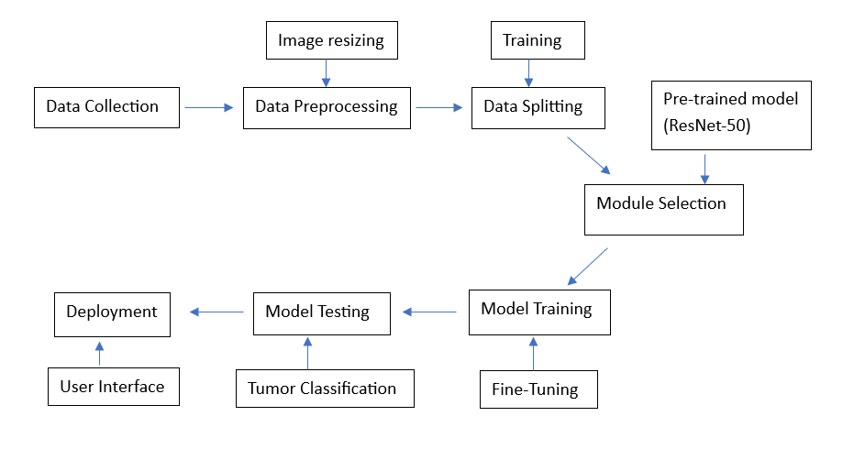
DESIGN ARCHITECTURE

Slide 15
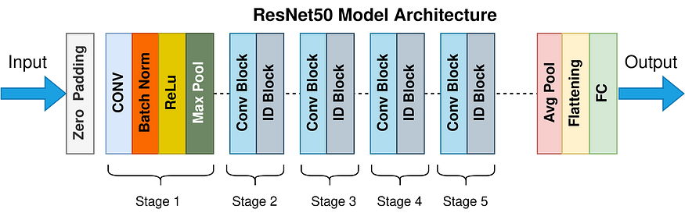
Fig : ResNet-50 Layered Architecture

Slide 16
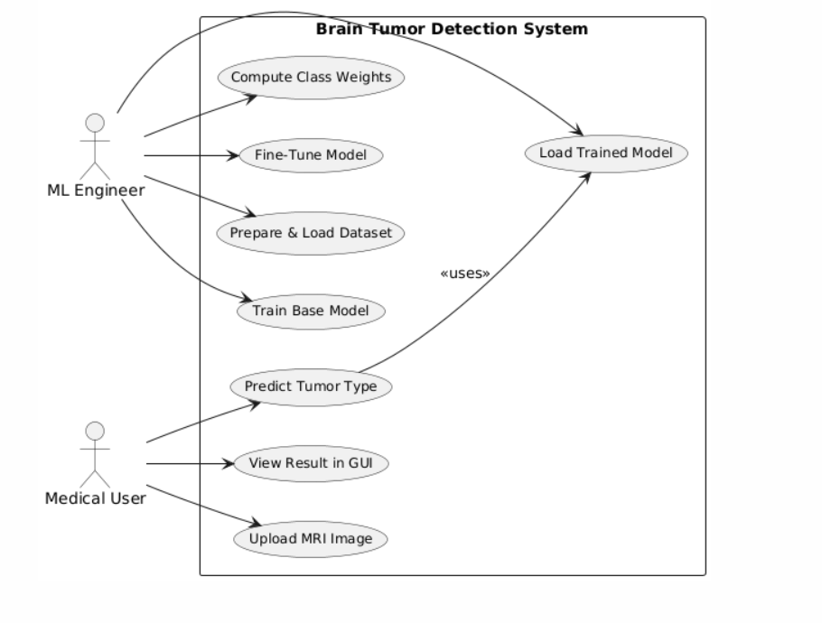
UML DIAGRAMS
Fig.1: USE CASE DIAGRAM

Slide 17
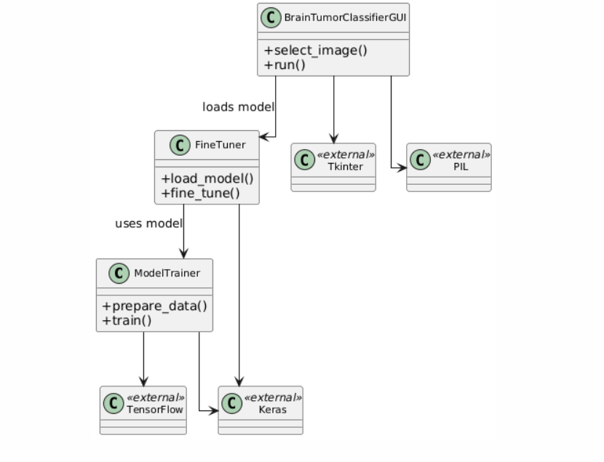
Fig.2: CLASS DIAGRAM

Slide 18
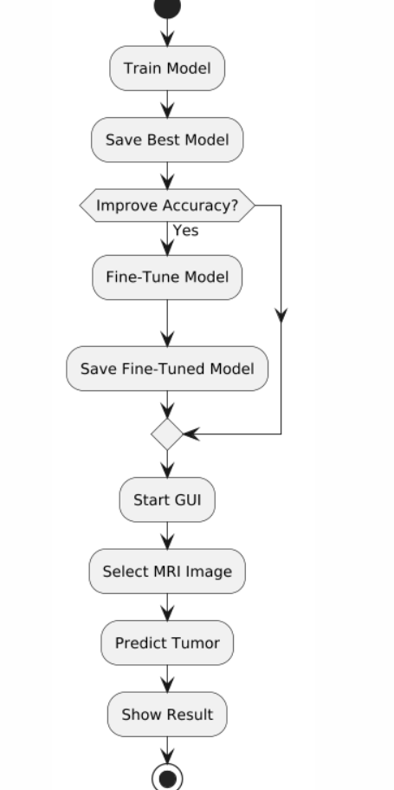
Fig.3: ACTIVITY DIAGRAM

Slide 19
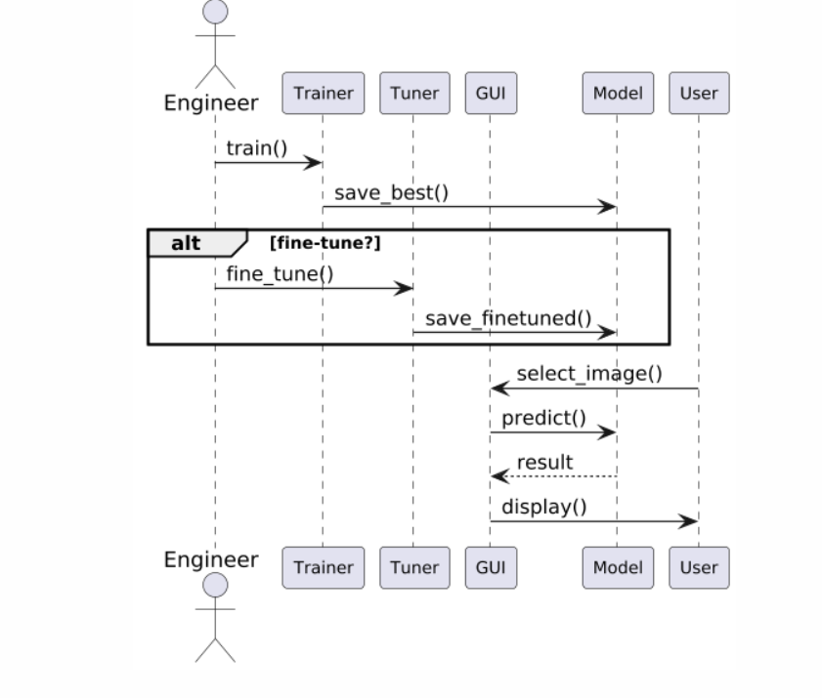
Fig.4: SEQUENCE DIAGRAM

Slide 20
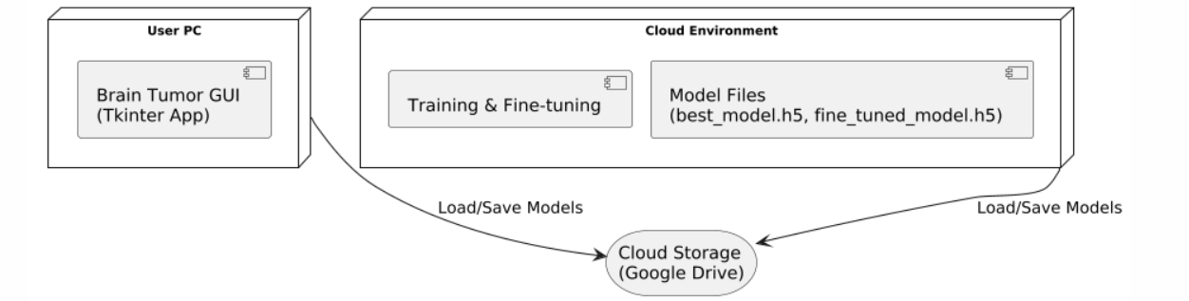
Fig.5: DEPLOYMENT DIAGRAM

Slide 21
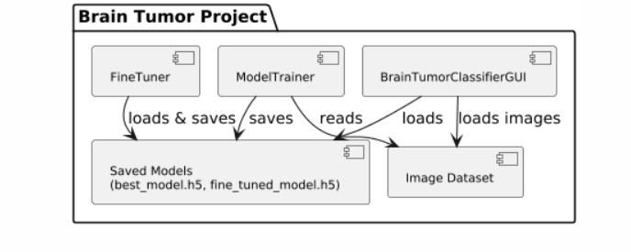
Fig.6: COMPONENT DIAGRAM

Slide 22
APPLICATIONS
Medical Diagnosis Helps doctors quickly and accurately identify brain tumor types.
Treatment Planning Supports personalized therapy decisions based on tumor classification.
Tumor Monitoring Tracks tumor growth or shrinkage during treatment.
Remote Healthcare Enables expert diagnosis in remote or underserved areas via telemedicine.
Medical Training Provides a learning tool for students and professionals studying brain tumors.

Slide 23
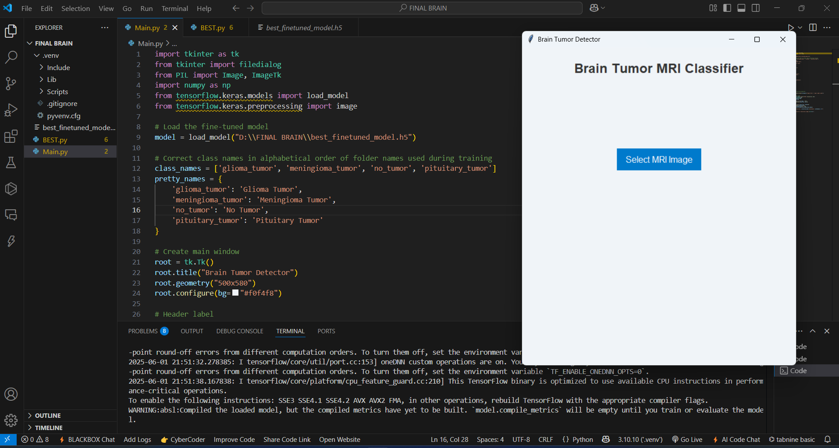
RESULTS
Fig.1: User selects an MRI image using the GUI to initiate brain tumor classification.

Slide 24
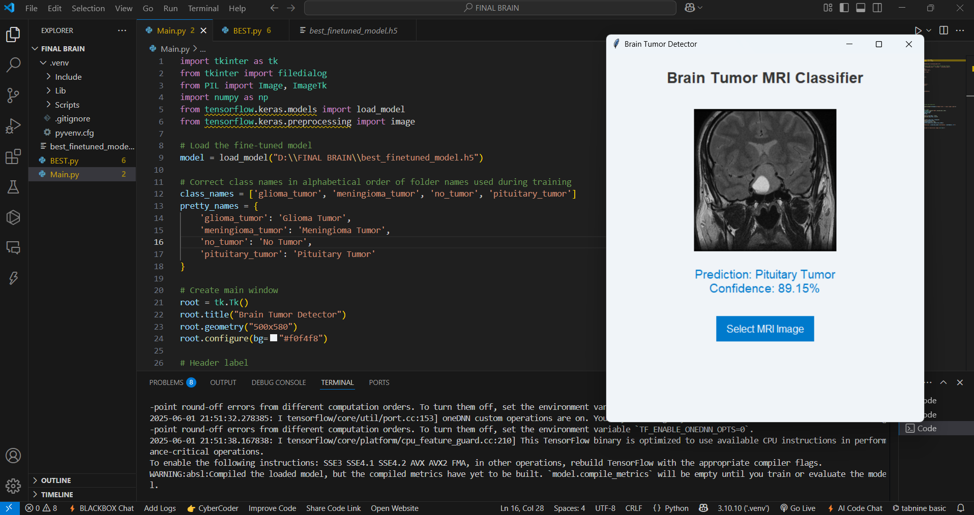
Fig.2: MRI image classified as Pituitary Tumor with 89.15% confidence.

Slide 25
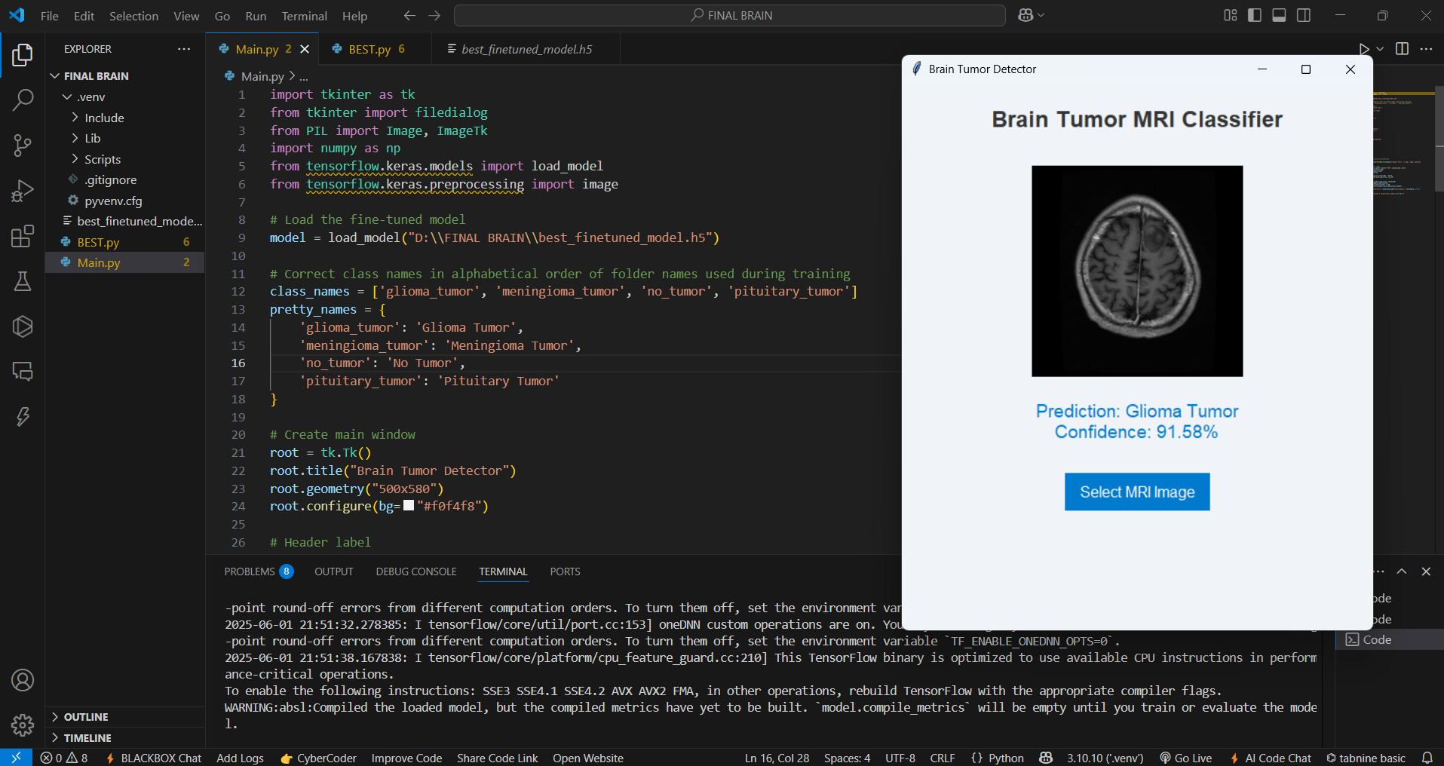
Fig.3: MRI image classified as Glioma Tumor with 91.58% confidence

Slide 26

Fig.4: MRI classified as No Tumor with high confidence of 99.66%.

Slide 27
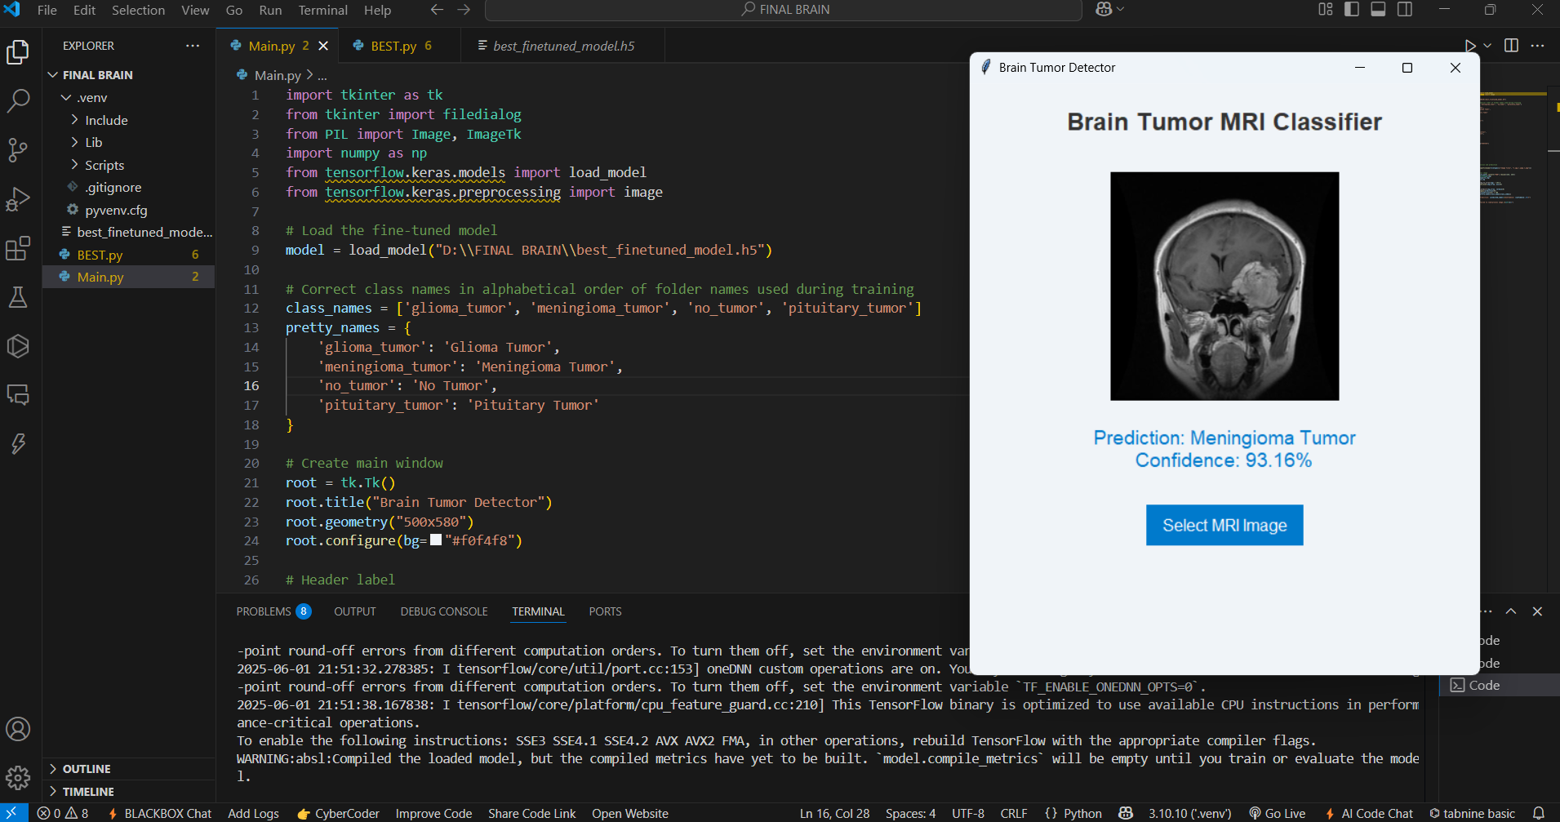
Fig.5: MRI classified as Meningioma Tumor with a confidence score of 93.16%.

Slide 28
Execution Link
https://drive.google.com/file/d/1V0JXjKgJMPYP76s6tq2ye4gEDKCselVQ/view

Slide 29
CONCLUSION
This project successfully implements brain tumor classification using MRI images with the help of a deep learning model based on the ResNet-50 architecture. The model was trained to classify brain scans into four categories: Glioma, Meningioma, Pituitary Tumor, and No Tumor, achieving an accuracy of around 90%.
To improve performance, techniques like image preprocessing, augmentation, and fine-tuning of a pre-trained model were applied.
A simple and interactive GUI application was also developed using Tkinter, allowing users to upload MRI images and receive immediate classification results, demonstrating a practical use case for medical assistance.
This project highlights the potential of deep learning in medical imaging and shows how AI can assist in early detection and faster diagnosis of brain tumors.

Slide 30
FUTURE ENHANCEMET
Increase Accuracy Use more MRI images to make the model even more accurate.
Add More Results Show extra details like how sure the model is, and where it might be wrong.
Try Better Models Use newer or smarter models to get better results.
Make it Online or Mobile Turn the project into a mobile app or website for easy use by doctors.
Connect with Hospitals Link it with hospital systems for quick and real-time tumor checks.
Improve Image Quality Add steps to clean and prepare the image automatically before prediction.

Slide 31
REFERENCES
[1] G. Hemanth, M. Janardhan, and S. Helen, “Convolutional Neural Networks (CNN), Conditional Random Field(CRF), AdaBoost, SVM,” presented at the IEEE 3rd International Conference on Trends in Electronics and Informatics (ICOEI), 2019.
[2] Vaishnavi R. Dhotaragi, S. Gramopurohit, V. Shalavadi, M. Kudari, and S. Jolad, “CNN and VGG-16 models used for detecting brain tumors from MRI images,” presented at the 2020 IEEE India Council International Subsections Conference (INDISCON), 2020.
[3] C. Malik, S. Rehman, and S. Kumar, “CNN-based tumor detection on MRI images,” presented at the 10th International Conference on Computing for Sustainable Global Development (INDIACom), 2023.
[4] M. Sajjad, S. Khan, A. Muhammad, K. Muhammad, S. W. Baik, and S. H. Ahmed, “Multi-grade brain tumor classification using deep CNN with extensive data augmentation,” in IEEE Access, vol. 7, pp. 42912–42924, 2019.
[5] A. Deepak and M. Ameer, “Brain tumor classification using deep CNN features via transfer learning,” in Computers in Biology and Medicine, vol. 111, p. 103345, 2019.

Slide 32
THANK YOU!!

